Slide 1




Non-Isolated Products
“Risk mitigation through optimum configuration, simulations and digital telemetry”.
September 12, 2013
GE Critical Power

Slide 2

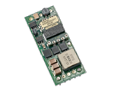
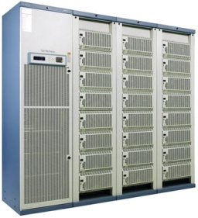

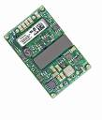






Total Solution Provider
Energy Systems Indoor/Outdoor
Board Mounted Power
3.3Vdc
3.3Vdc
Load
2.5Vdc
1/8 bricks
1.2Vdc
48V, 24V, 12V
Bus
12Vdc
3.3Vdc
Power Shelf Solutions
1/4 bricks
2.5Vdc
1.8Vdc
CPS6000 Family
Custom Power Supplies
Standard Rectifiers
3.3Vdc
5.0Vdc
CPL-Series
Custom Rectifiers
1/16 bricks
12 Vdc
October 8, 2013

Slide 3
DLynx™, Non-Isolated solutions
Energy Systems Indoor/Outdoor
Board Mounted Power
3.3Vdc
3.3Vdc
Load
2.5Vdc
1/8 bricks
1.2Vdc
48V, 24V, 12V
Bus
12Vdc
3.3Vdc
Power Shelf Solutions
1/4 bricks
2.5Vdc
1.8Vdc
CPS6000 Family
Custom Power Supplies
Standard Rectifiers
3.3Vdc
5.0Vdc
CPL-Series
Custom Rectifiers
1/16 bricks
12 Vdc
October 8, 2013

Slide 4
GE Critical Power, DLynx™ POL modules
“Risk mitigation through optimum configuration, simulations and digital telemetry”.
Corporate,
  GE Critical Power is #1 in standard POL solutions by revenue.
  IPC9592 manufacturing guidelines, Demonstrated field MTBF levels in excess of 1B hours
  2 licensed partners as well as adhering to DOSA standards.
  Purchasing strength of critical power components
Technology strength,
  Extensive pre-release testing, accelerated life testing, 4 corner testing, etc.
  Impressive thermal derating, full power up to 70degC, no airflow on all modules.
  Fast design-in, fast time to market; Getting it right on the first pass
  Wide temp range, -40 to 85deg, “-D” -40 to 105degC
  Power Good signal
  Over Temperature Protection
  Over Current Protection
  Compensation tuning on all modules, Tunable Loop™

Slide 5
GE Critical Power, DLynx™ POL modules
“Risk mitigation through optimum configuration, simulations and digital telemetry”.
Corporate,
  GE Critical Power is #1 in standard POL solutions by revenue.
  IPC9592 manufacturing guidelines, Demonstrated field MTBF levels in excess of 1B hours
  2 licensed partners as well as adhering to DOSA standards.
  Purchasing strength of critical power components
Technology strength,
  Extensive pre-release testing, accelerated life testing, 4 corner testing, etc.
  Impressive thermal derating, most modules up to 80degC & NC
  Fast design-in, fast time to market; Getting it right on the first pass
  Wide temp range, -40 to 85deg, “-D” -40 to 105degC
  Power Good signal
  Over Temperature Protection
  Over Current Protection
  Compensation tuning on all modules, Tunable Loop™

Slide 6
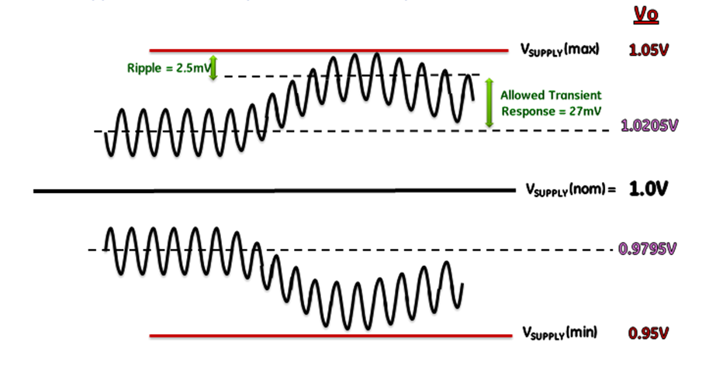
Voltage Budget Issue: 1.0V issue..
  Requirement: 1.0V, +/-5% total regulation window. Includes set point accuracy, noise, ripple and a 50% step load transient response.
The Tunable Loop™ easily addresses very challenging Transient Response issues.

Slide 7
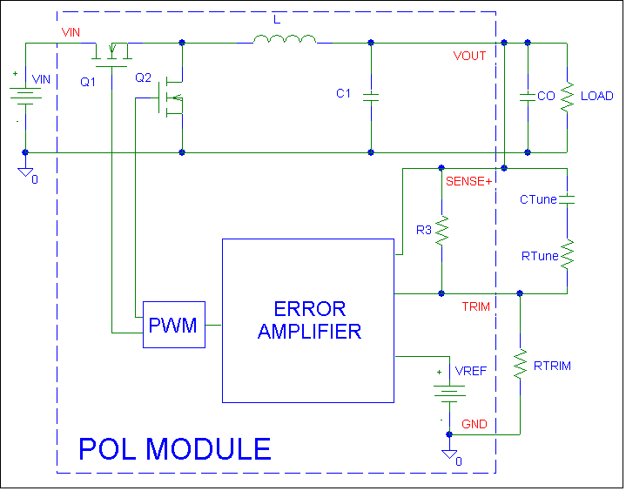
Concept of the Tunable Loop™
V_{out} or SENSE+ pins
External Components can be added to re-shape the control loop
TRIM pin
CTune and RTune influence the modules voltage control loop
October 8, 2013

Slide 9

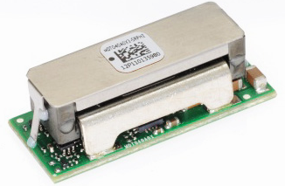
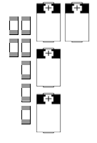
Example Design with & without Tunable Loop™
High Current Design (MDT040)
  12V to 1.5V @ 40A, 20A step Load, need to meet 3% Vout
No Tunable Loop
  12 x 330μF Sanyo 2R5TPC330M
  10 x 47μF ceramic (1206 size)
With Tunable Loop
  7 x 47μF ceramic (1206 size)
  4 x 330uf Sanyo 2R5TPC330M
Output Caps: without Tuning
Output Caps: with Tuning
MDT040 Module
October 8, 2013

Slide 10
Dlynx™, Risk Mitigation with new
“Power Module Wizard Web Tool”
Pspice Modeling,
Transient response
Input reflected ripple
Bode Plots
Excel, Tunable Loop™ tool
Excel, efficiency tool
Excel, Voltage Programming tool
Web based module selector guide
New Web Tools !!
  Power Module Wizard,
    Comprehensive guide to designing in GE POL modules
    Greatly expanded tools in web version vs. the legacy tools.
    Simulate and analyze on web or download the tool to PC
    Registered users can save work at anytime during analysis and share with colleagues or GE FAE.

Slide 11
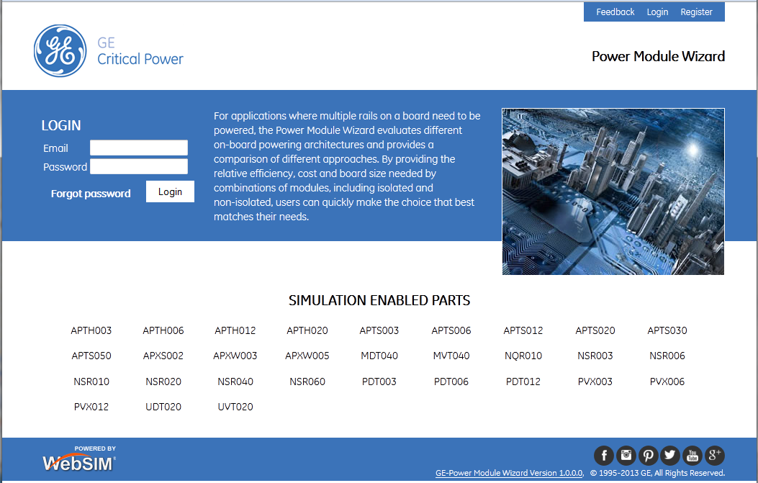
New Web-Tools, introduction..
The Login Screen…
One-time, short registration – login based on email ID/password

Slide 12
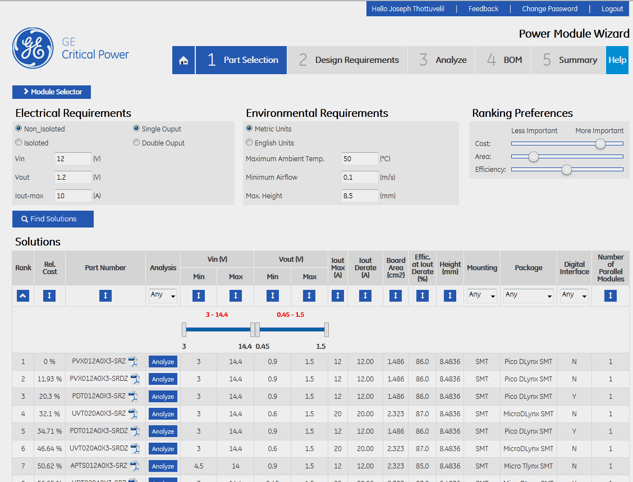
New Web-Tools, introduction..

Slide 13
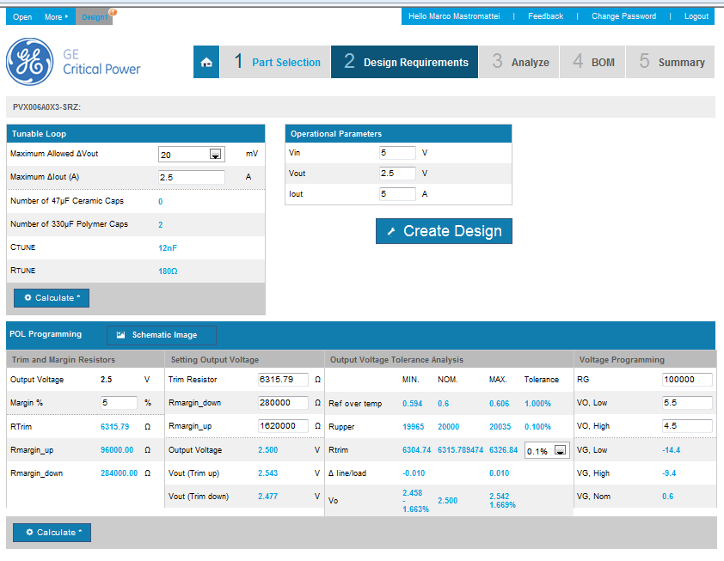
New Web-Tools, introduction..
This design has unsaved changes

Slide 14
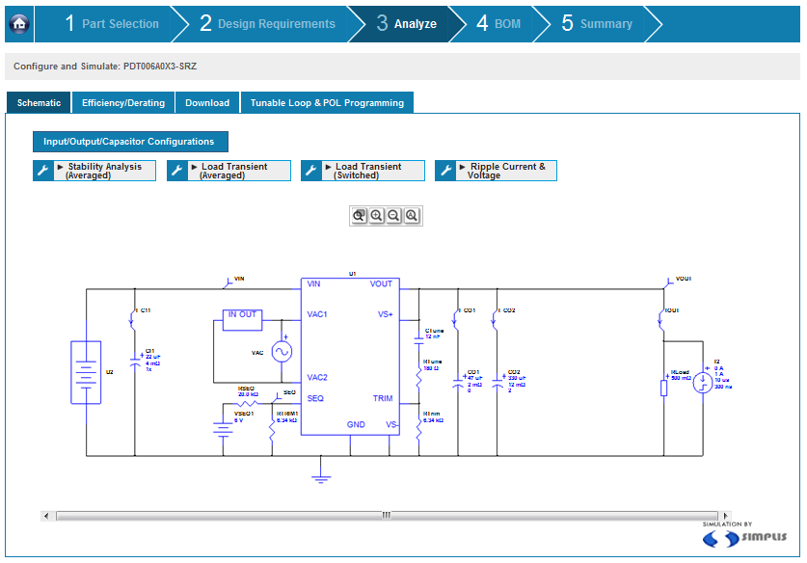
New Web-Tools, introduction..

Slide 15
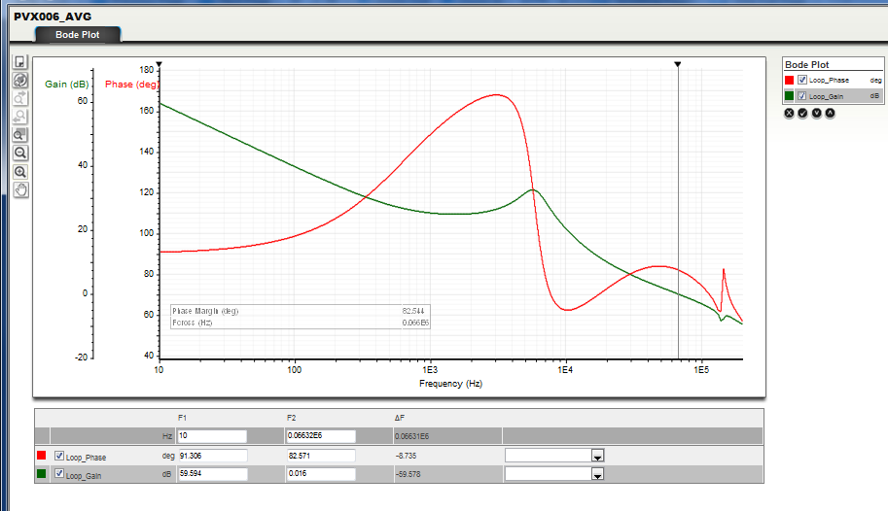
New Web-Tools, introduction.. (Stability Analysis)

Slide 16
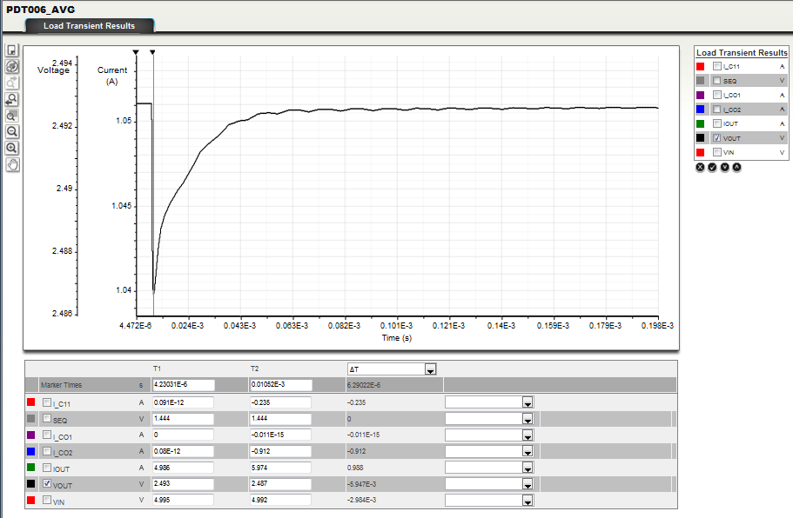
New Web-Tools, introduction.. (Load Transient)

Slide 17
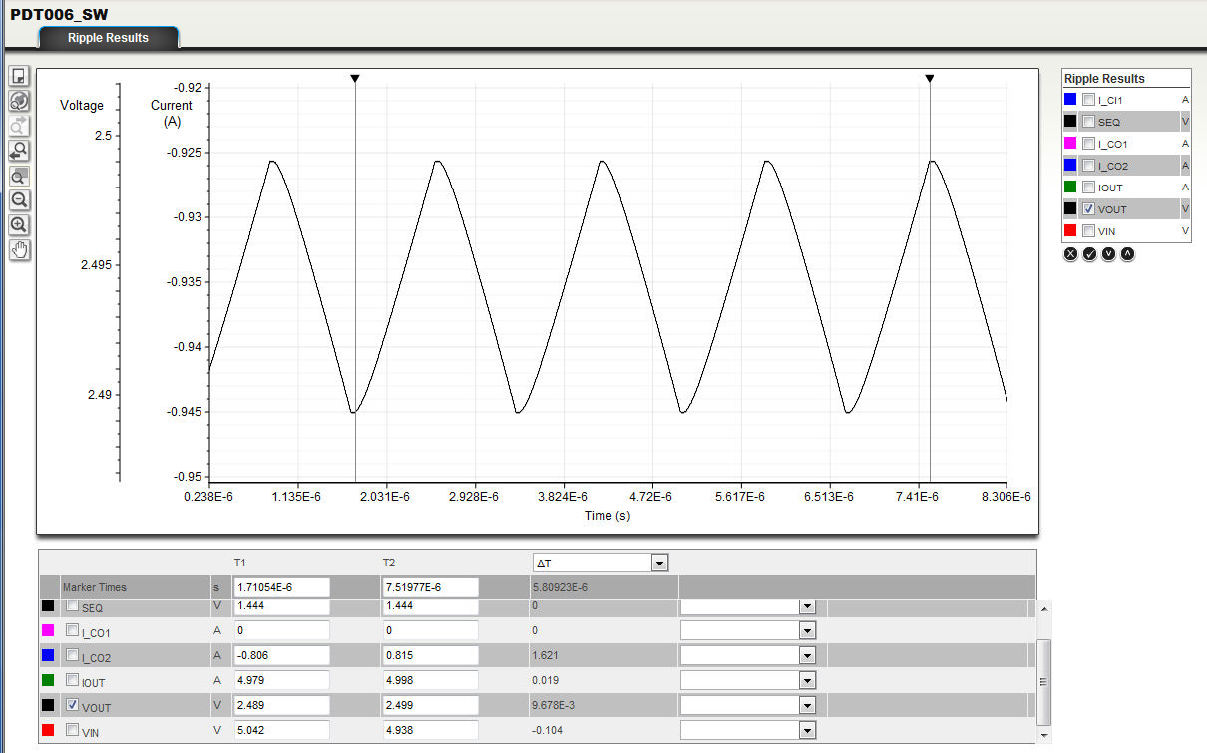
New Web-Tools, introduction.. (Output Ripple)

Slide 18
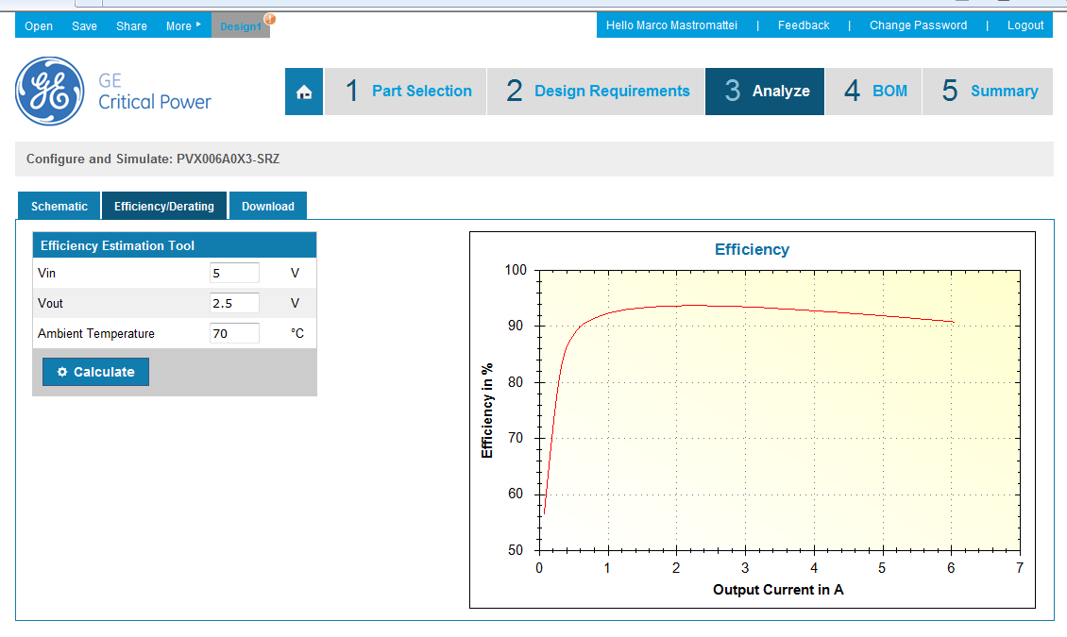
New Web-Tools, introduction.. (Efficiency)

Slide 19
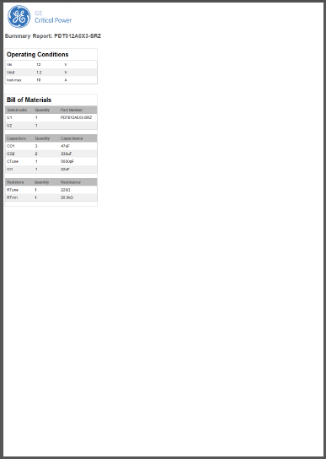
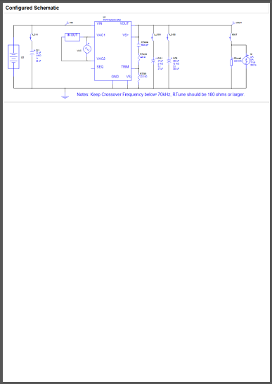
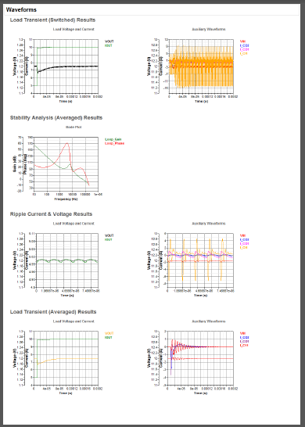
Summary Report
Summary report available for download as .pdf file or for printing
Report contains
  Input by user such as Operating conditions
  BOM
  Simulation schematic
  Simulation results from all analyses done

Slide 20
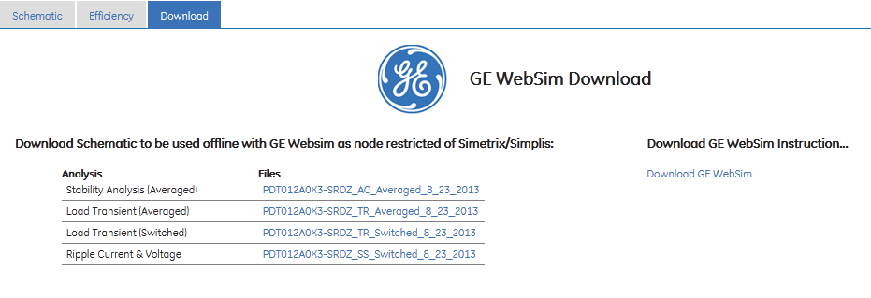
Offline Simulation
GE WebSim Simulator available for download
Simulation schematics available for download
GE WebSim Simulator needs to be downloaded and installed – one time only
  Both SIMPLIS and SIMetrix simulators included along with schematic capture and plotting tools
  Node restricted version
Simulation schematics can be downloaded and worked offline
  Allows topology changes, different analyses

Slide 21
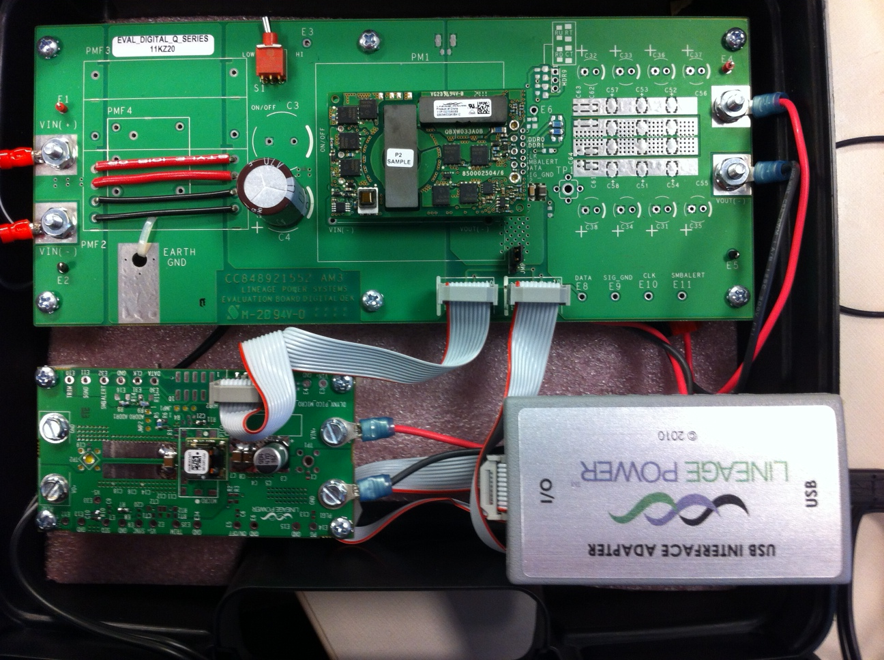
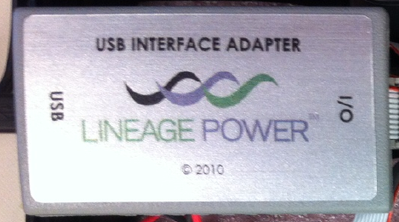
GE Digital Power Insight™
DLynx™, Risk Mitigation…
GUI
Digital Power Insight™,
Command Line Interface,
Classic GUI
New PRO-GUI
© 2009 Lineage Power

Slide 22
DLynx™, Risk Mitigation…
GE Digital Power InsightTM
Digital Attributes,
  Digital Adjust, +/-25%
  Digitally Telemetry, Vout, Vin, Iout
  Digitally Margin Vout to a pre-determined high or a low level
  Adjust OVP & UVP window
  Adjust Startup rise time
  Adjust Overcurrent Warning flag..
  Adjust input under voltage lockout
  Fault indicators
  2 different Graphic User Interfaces..

Slide 23
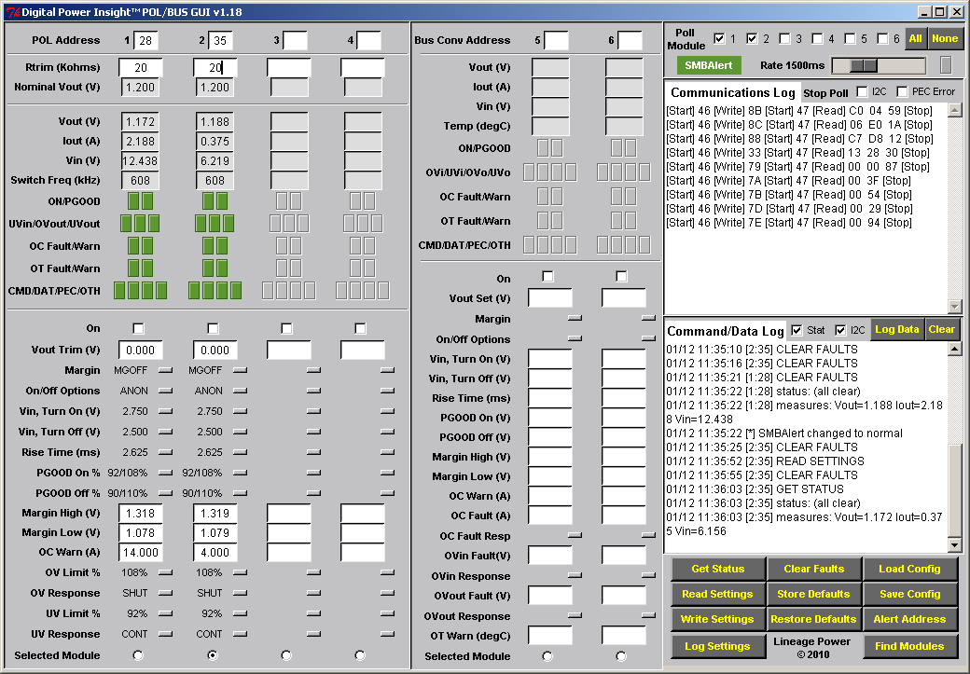
Background, review of “Classic-GUI”
- Classic GUI -

Slide 24
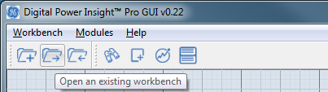
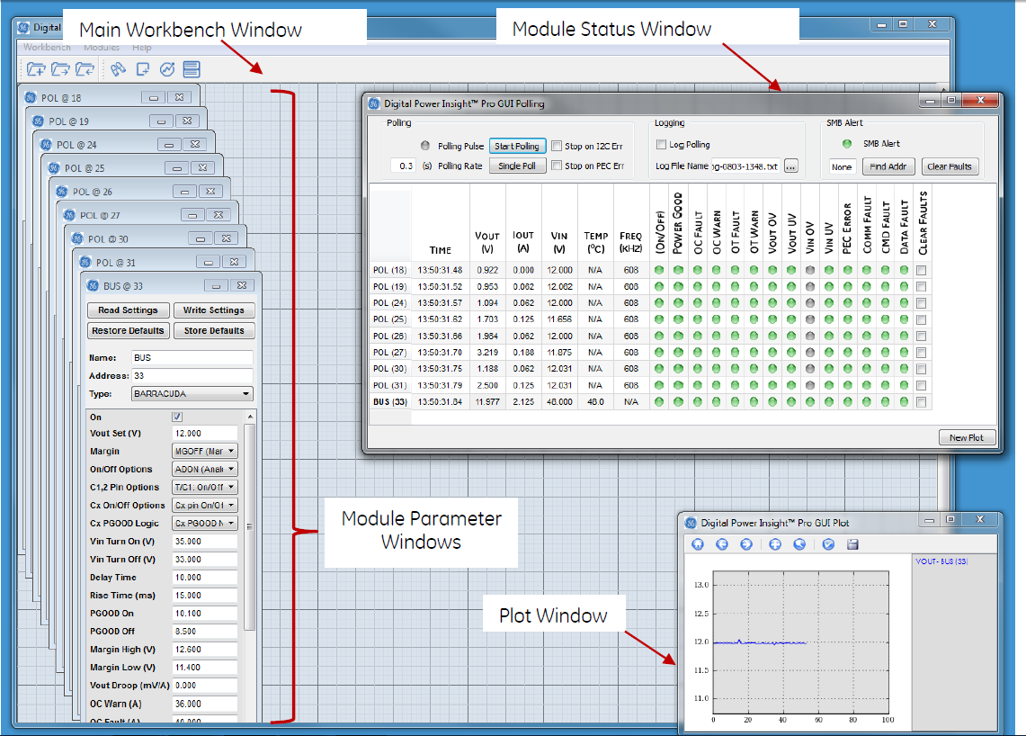
NEW Pro – GUI…

Slide 25
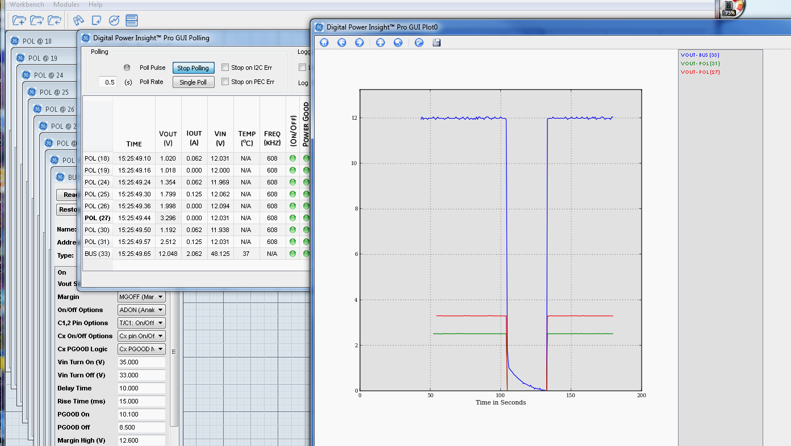
NEW Pro – GUI… Plotting

Slide 26




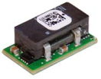


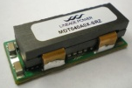
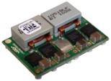
GE Non-Isolated POL Roadmap
Pico
2A
2A
Pico T
Analog
SlimLynx™
PNVX002A0X-SRZ
3A
micro
A&D
Dual 6A
UDXS0606
A & D
4.5mm hgt, 2A
Late 2013 or early 2014
3A
3A
pico
A&D
6A
micro
A&D
Dual 3A
UDXS0303
A & D
6A
6A
pico
A&D
ProLynx™
12A
Available Now!
12A
micro
A&D
12A - P
mega
9-36Vin
APXW012
2014
12A
pico
A&D
20A
20A
micro
A&D
Dual 12A
UDXS1212
A & D
Early 2014
30A
40A
40A
mega
A&D
50A
50A
GIGA T
Analog
2H 2014
80A
GIGA D
Digital
60A+
2012
2013
2014

Slide 27
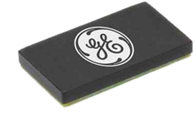
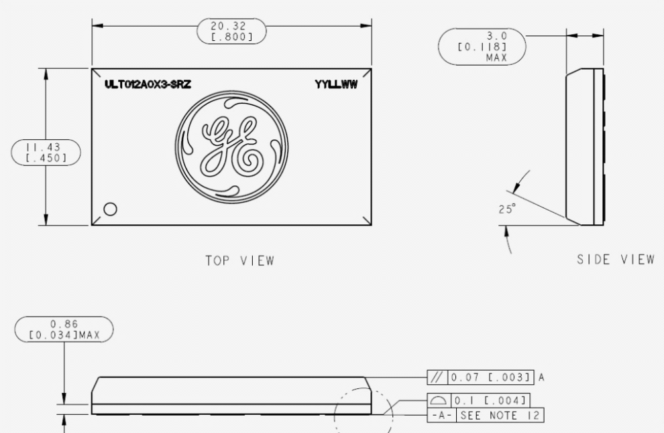
GE SlimLynx™
3 mm (Max) x 20.32 mm x 11.43 mm
  (0.118 in x 0.8 in x 0.45 in )
Input range 3V to 14.4VDC
Output programmable, 0.6V to 5.5VDC
Tunable Loop, compensation optimization
EZ-Sequence tracking pin.
Analog and Digital Power Good signal.
Frequency Sync capability
Overcurrent and Overtemp protection

